Slide 1
Review of Methods for Identifying Versioned and Plagiarized Documents
- Hrishikesh Gaadkari

Slide 2
What the paper introduces?
Ranking - Identity Measure
Fingerprinting – Anchor Strategy
Identifying co-derivatives
Accuracy
Outperform other techniques
Effectiveness evaluation – HFM and separation measures
Identity Measure is Superior
Notes:
Propose identity measure for ranking family and anchor strategy for fingerprinting technique About coderivatives documents originating from the same source.
Accurately identify the coderivative documents Compare with other techniques. Make use of two collections one is the test documents and a large collection of
d. Recall and precision not sufficient.

Slide 3
Ranking
Determine Similarity score by Similarity measure function
High score : Top ranked documents
Two families of Similarity measures
Standard measures
Identity measures
Notes:
Based on the query the similarity score is assigned to each document. The documents are sorted by decreasing score and top ranked documents are returned to the user. The information required to evaluate the query depends on the similartiy measure used.

Slide 4



Standard Measures
Inner Product Similarity Measure
Normalized Inner Product Similarity Measure
Cosine Measure
Notes:
Query document, Number of documents in the collection, distinct terms in the collection, number of occurrences of a particular term in a documents , weight and length of documents. One-n comparing. One better than the other. !) favour long documents 2) short documents 3) favours short queries. All of them not favourable for detecting co-derivatives. Inted for ad-hoc querying. So then what about compairing pairs of full length documents for derivation.

Slide 5
Introducing New Measure - Identity
n-n problem
Rare term preference ranking
Variations of Cosine Measure
Variation 1
Variation 2
Variation 3
Variation 4
Variation 5
Notes:
Documents with the term which is rare in the collection are given high similarity scores.

Slide 6
Another approach - Fingerprinting
n-n problem
Fingerprint Generation
Fingerprint Granularity
Fingerprint Resolution
Substring Selection Strategy
Notes:
After comparing, each fingerprint assign scores.The choice of a selection strategy greatly impacts the accuracy and efficiency of the fingerprinting process.

Slide 7
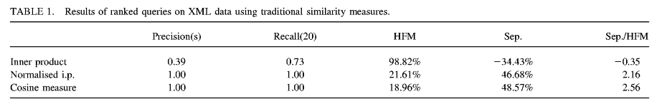
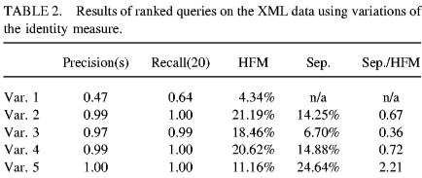
Experiments
Notes:
Test data: huge collection with10 similar documents co-derivatives. Precision is proportion of returned documents that are correct answers. Recall is proportion of correct answers that are returned

Slide 8
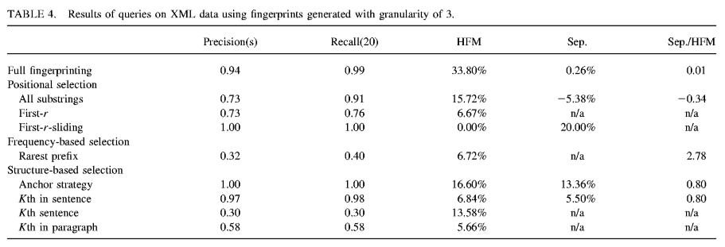

Slide 9
Near-Duplicate Detection by Instance-level Constrained Clustering

Slide 10
Overview
More accurate
Near-duplicate clusters – document attributes and content structure
Must-link
Cannot link
Family-link
Notes:
Email relayer approximate file size

Slide 11
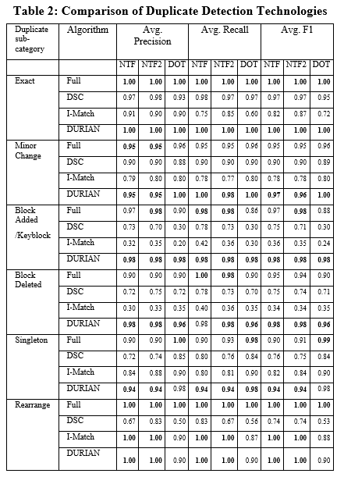
Test Results

Slide 12
Thank you

